Slide 1














ONLINE DOCTOR APPOINTMENT SYSTEM
Presenters :
Sidra-Tul-Muntaha (084)
Sidra liaqat (083)

Slide 2

INTRODUCTION:
The Online Doctor Appointment System is a web-based application facilitating booking, managing, and reviewing doctor appointments, enabling users to browse doctors, book/edit/cancel appointments, submit reviews, and view history.

Slide 3


BACKGROUND & PURPOSE
BACKGROUND
PURPOSE
The purpose is to develop an efficient and user-friendly Online Doctor Appointment System to conveniently search for doctors, view availability, and book, reschedule, or cancel appointments online, minimizing wait times and improving communication.
Traditional appointment booking methods are often manual, time-consuming, and prone to errors, causing long waiting times and limited accessibility.

Slide 4


KEY FEATURES
01
02
03
User-Friendly Interface
Secure Database Integration
Form Validation & Error Handling
04
Full CRUD Functionality

Slide 5
TOOLS & TECHNOLOGIES USED
Frontend Technologies:
Backend Technologies
CS , HTML , JAVASCRIPT
PHP
Database Management
Development Environment
MYSQL
XAMPP (Apache , MYSQL)

Slide 6
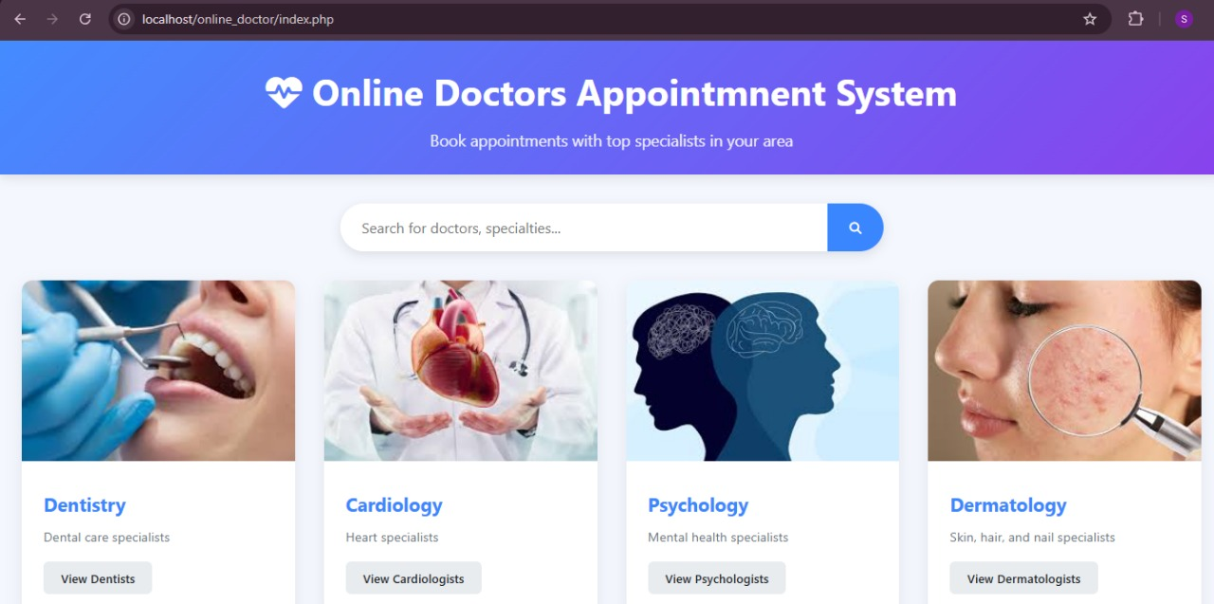
HOME PAGE OVERVIEW
The home page displays doctor specializations and search functionality.

Slide 7
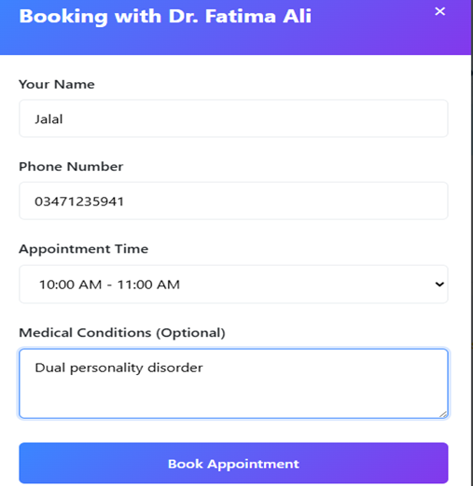
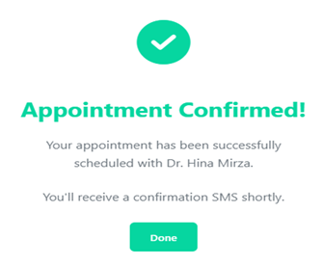
PATIENT BOOKING FORM AND CONFIRMED

Slide 8
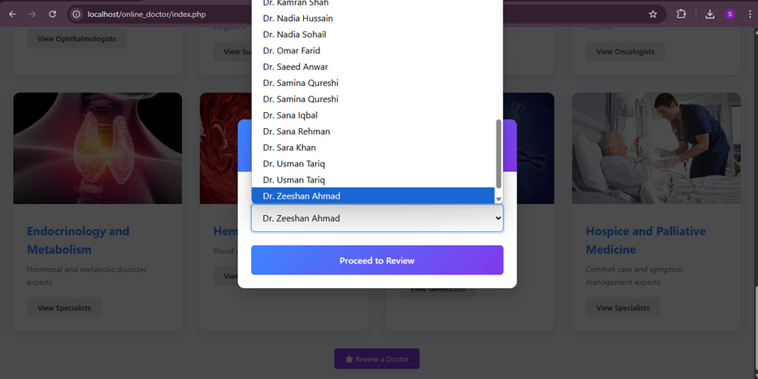
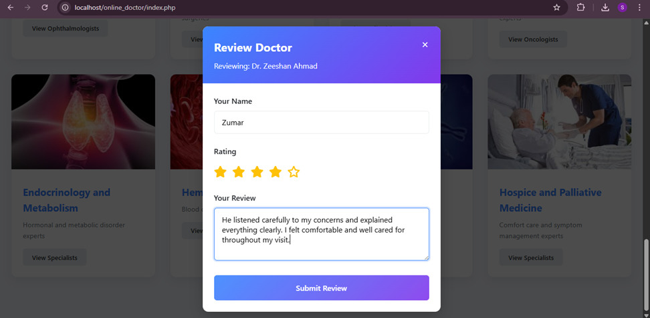
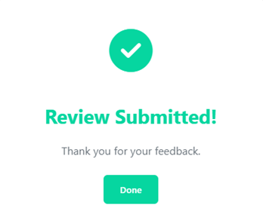
REVIEW SUBMISSION FORM AND SUBMITTED

Slide 9

DATABASE DESIGN:
Doctors Table
Patients Table
Appointments Table
Reviews Table

Slide 10
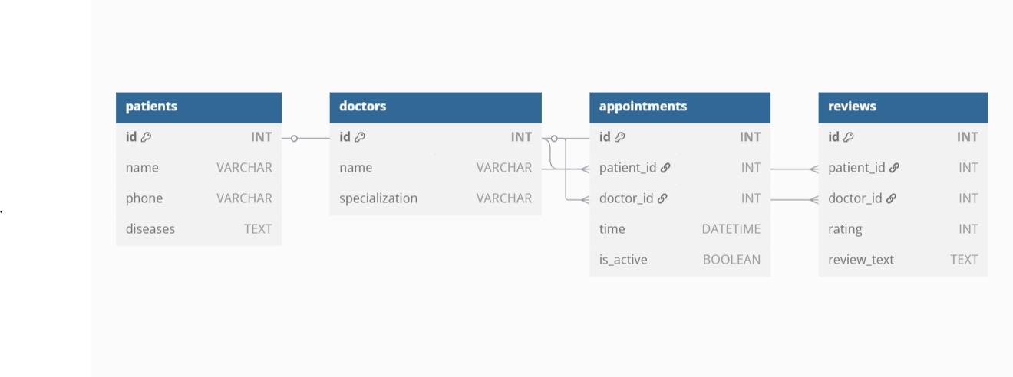
ER DIAGRAM

Slide 11
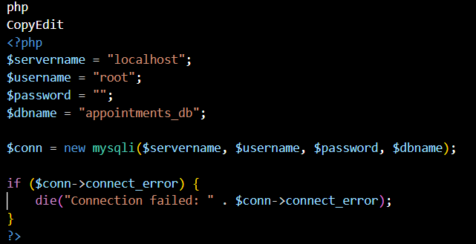
DATABASE CONNECTION
The PHP code connects to the MySQL database using specified server, username, password, and database name.
It includes error handling to terminate the connection if the database is unreachable.

Slide 12
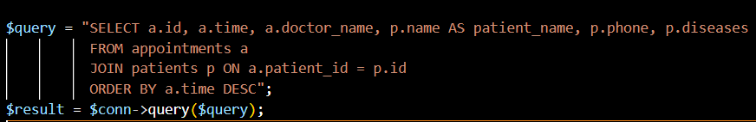
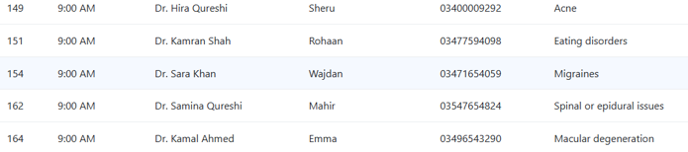
SQL QUERIES & INTEGRATION
SELECT (Fetch Appointments)
Purpose: Retrieves all appointments with patient details.

Slide 13
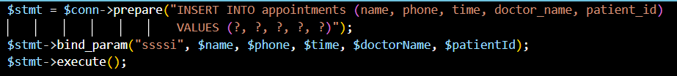
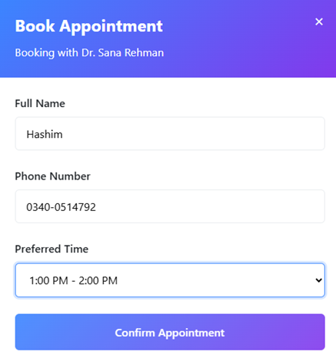
SQL QUERIES & INTEGRATION
INSERT APPOINTMENTS
Add New Appointment
This prepared statement securely adds a new appointment record into the database.

Slide 14
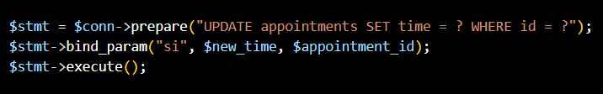
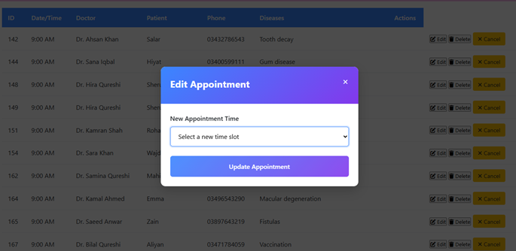
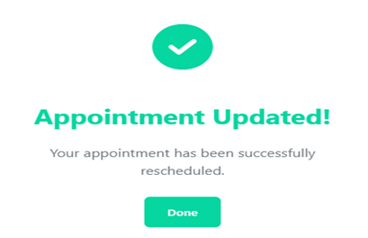
SQL QUERIES & INTEGRATION
UPDATE APPOINTMENTS
Reschedule Appointment:
This prepared statement updates the time of an existing appointment based on its ID.

Slide 15
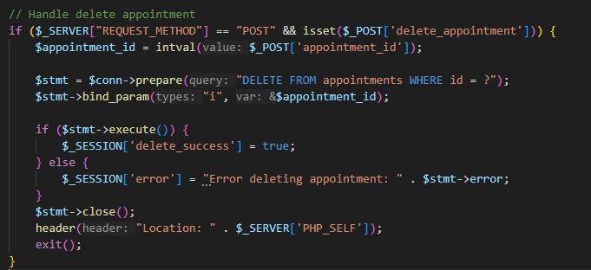
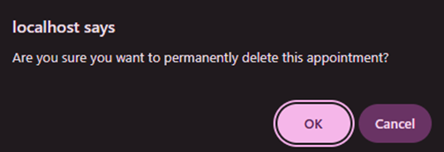
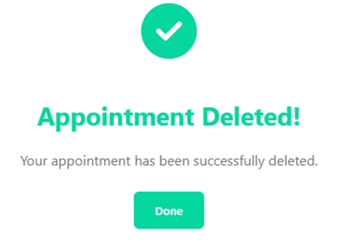
SQL QUERIES & INTEGRATION
DELETE APPOINTMENT
Cancel Appointment
This prepared statement securely deletes an appointment record from the database using its ID.

Slide 16
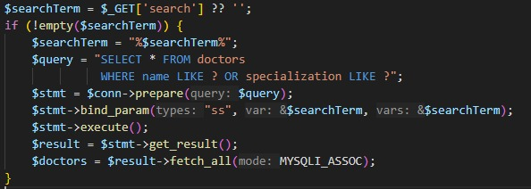
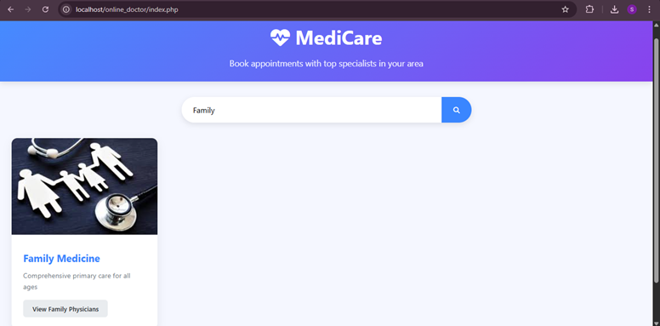
SQL QUERIES & INTEGRATION
Doctor Search
Doctor Search Functionality
This dynamic query allows users to search for doctors by name or specialization using a provided search term.

Slide 17
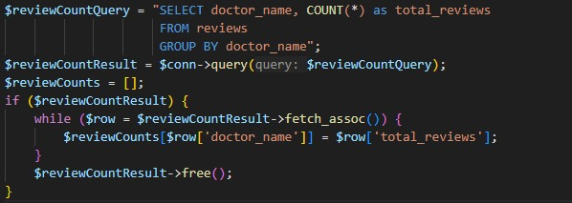
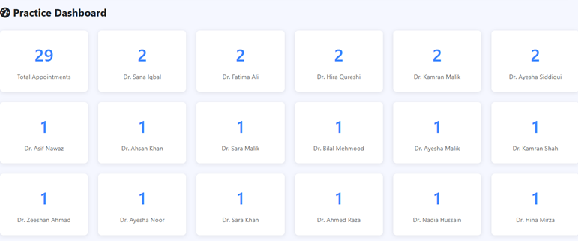
SQL QUERIES & INTEGRATION
Counting Reviews per Doctor
Helps display the total number of reviews per doctor.

Slide 18
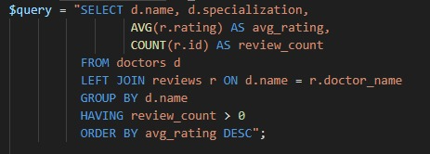
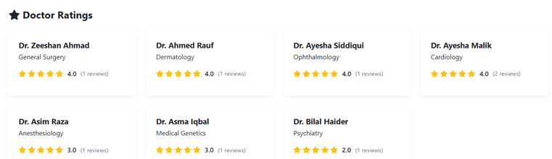
SQL QUERIES & INTEGRATION
Calculating Average Doctor Ratings
Computes average ratings and review counts for each doctor to display in the ratings dashboard.

Slide 19
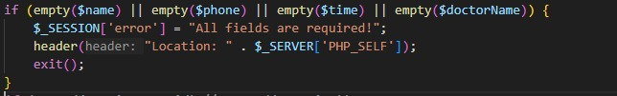
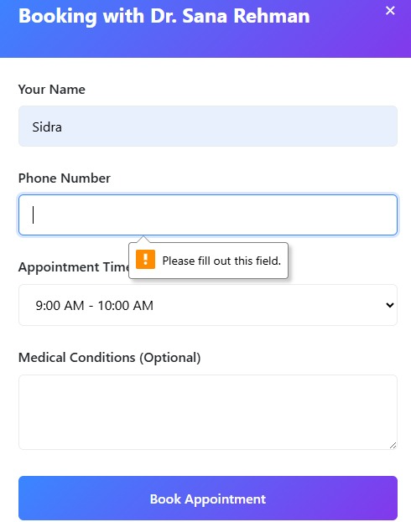
VALIDATION & ERROR HANDLING
VALIDATION
Required Field Validation
This example demonstrates validation to ensure that all required form fields (name, phone, time, doctorName) are filled before submission.

Slide 20
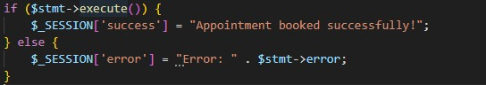
VALIDATION & ERROR HANDLING
ERROR HANDLING
Success and Error Messaging:
Success messages confirm successful operations, while error messages provide details on any failures, aiding debugging and user experience.

Slide 21


CONCLUSION
Simplifies booking and managing appointments online
Improves convenience for patients and doctors
Built using PHP, MySQL, and web design skills
Tackled challenges like security and validation
Can be enhanced with login and notification features

Slide 22
THANK YOU VERY MUCH!

